Slide 1
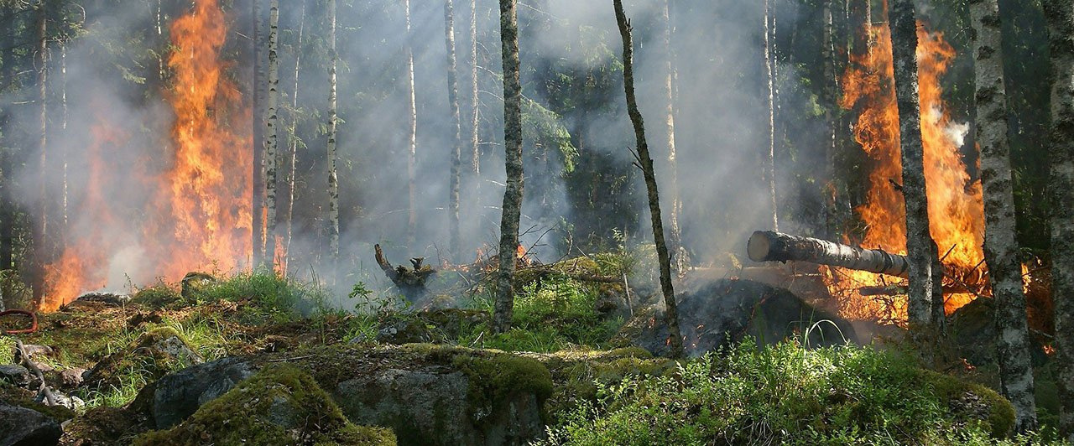
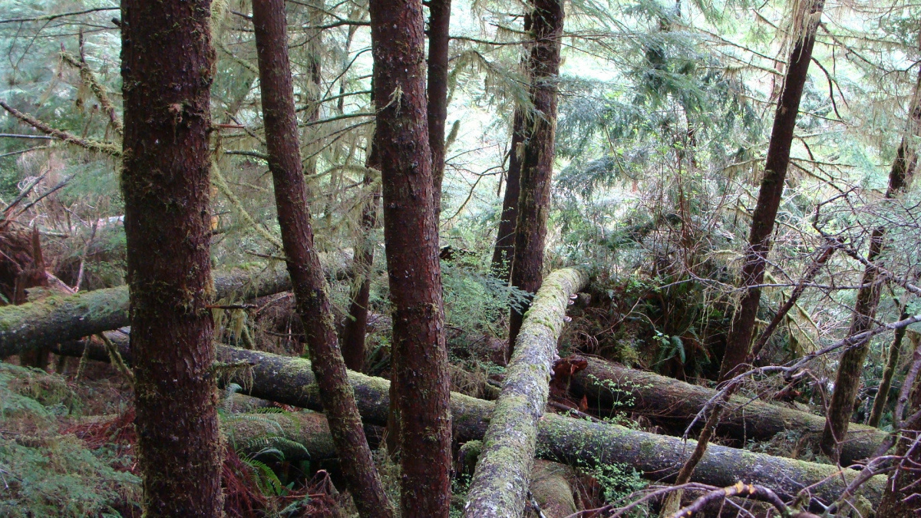



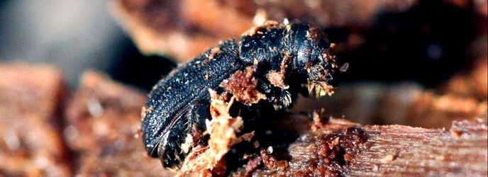
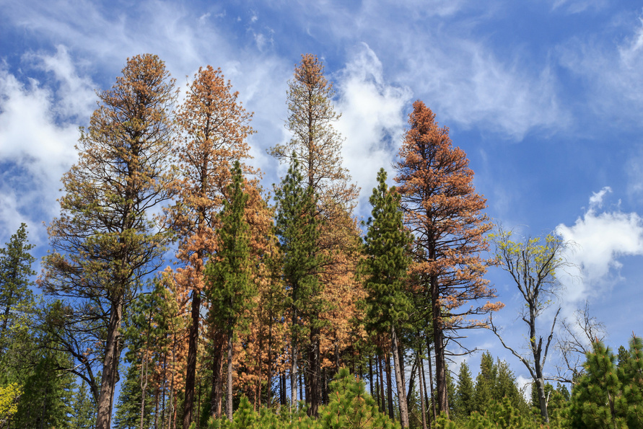
(University of Santa Barbara, n.d.)
Categorizing Non-stand Replacing Disturbances as Abiotic or Biotic
Madison “Madi” Brown, BSc |FRE 490 Final Project madib98@student.ubc.ca
https://github.com/MadiSophia/FRE_490_project
@MadiSophiaBrown
(National Parks Service, 2016)
Research Supervisor:
Dr. Nicholas Coops
Supervisory Committee:
Dr. Alexis Achim & Dr. Jeanine Rhemtulla
1
(Public Broadcasting Service, 2019)
(Oregon State University, n.d.)

Slide 2


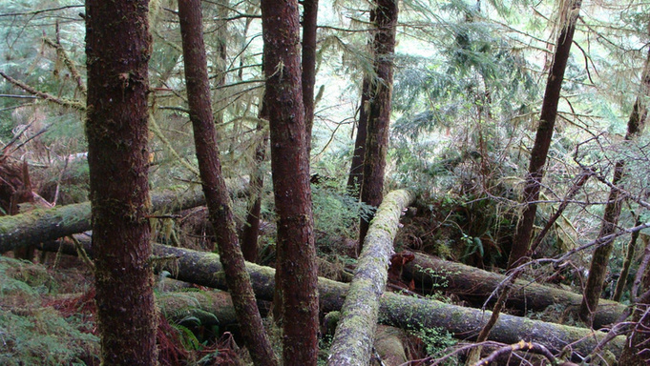
Introduction and Background
Non-stand Replacing Disturbances (NSRs)
Terrestrial disturbances attributed to climate change and are increasing globally (Shi et al., 2021)
NSRs are events that result in complete removal of trees.
Lead to heterogenous stand structures relating distribution and quantity of biomass , & changes in ecosystems services ( Payette et al. 1990)
Making NSRs critical to monitor for future forest management strategies
(National Parks Service, 2016)
(Public Broadcasting Service, 2019)
(University of Santa Barbara, n.d.)
(Oregon State University, n.d.)
2
Notes:
Variable disturbance intensities and spatial patterns often lead to heterogenous stand structures relating distribution and quantity of biomass , in addition changes in ecosystems services ( Payette et al. 1990)
2

Slide 3



Introduction and Background
Conventional Forest Inventories in Canada
Forest inventories in Canada help determine the location, extent, condition, composition, and structure of forests, and play a key role in the sustainable management of resources (Tompalski et al., 2021).
Conventional forest inventories generally involve a combination of aerial images and ground plots
Lack temporal resolution and detail in stand characteristics to detect and quantify NSRs.
3
Notes:
Attributes such as height, species, volume, diameter at breast height (DBH), and stem density are taken from ground-based measurements and then linked to the interpreted polygons forming the baseline of inventories (Gillis and Leckie, 1996).
3

Slide 4
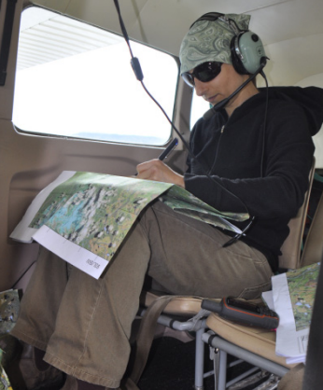
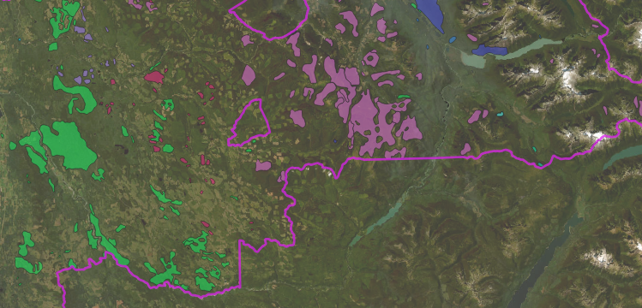
Introduction and Background
BC Aerial Overview Survey
BC Aerial Overview Survey (AOS) - provincial landscape-level survey.
Used to detect major forest disturbances caused by insects, diseases, animals, and abiotic factors (Coggins et al., 2008).
(Ministry of Forests, n.d.)
4

Slide 5
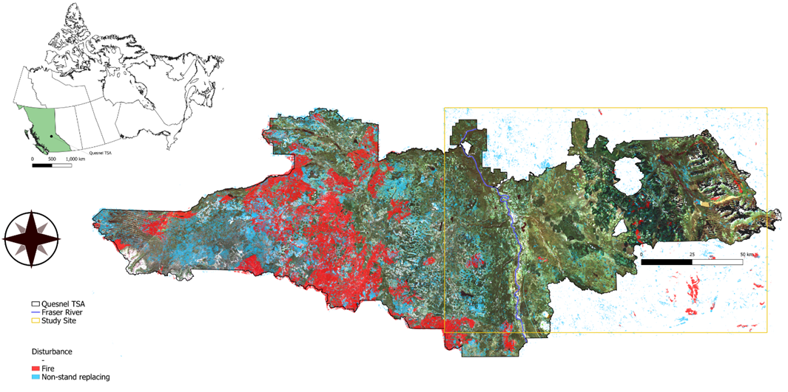
Introduction and Background
Study Site Quesnel Timber Supply Area
Brown et al., (unpublished manuscript)

Slide 6

Introduction and Background
Research opportunities
There is a need to update forest inventories on a more frequent basis to quantify the impact of NSRs.
Increased accessibility of moderate resolution satellite imagery (Landsat/Sentinel-2) & the development of cloud-based computing solutions has enabled algorithms which detect changes in forested landscapes to be more easily developed and tested across large spatial scales ( Wulder et al., 2012).
Allowed for even more temporally dense times series and therefore the potential to accurately detect land cover change and disturbances at a weekly or monthly time-step.
6

Slide 7
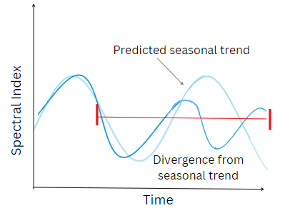
Introduction and Background
Bayesian Estimator of Abrupt Change, Seasonality, and Trend (BEAST) Algorithm
BEAST under assumption, many "best" models for the same data. It is more effective to weigh many different models with varying probabilities rather than trying to find a singular “best-fit” for the data (Zhao et al., 2019).
This seasonality makes it an effective choice for places such as Canada with seasonal variation.
The algorithm has the ability to capture moderate to high-magnitude changes with both positive and negative trajectories (Li et al., 2022)
BEAST algorithm had 88.7% accuracy of change detection in Quesnel (Mulverhill et al., 2023)
5
Notes:
Given a time series of NBR values, seasonality of each pixel is calculated by using a predicted sinusoidal pattern, and if a cell diverges from trend, it is flagged and probability of change calculated (Zhao et al., 2019).
5

Slide 8
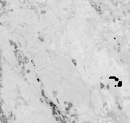

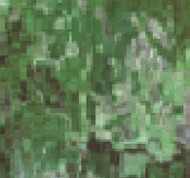
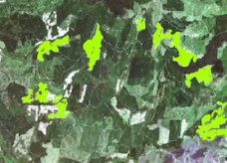
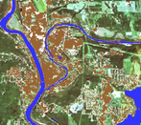
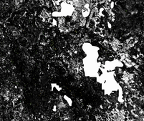
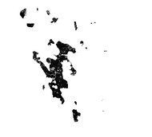
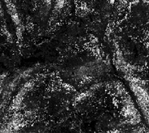
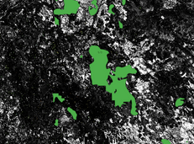
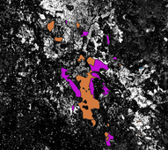
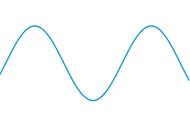



Introduction and Background
Previous Work
1
Time Satelite Imagery
NBR Processed Imagery
16- day Composites
Masked Composite
4
Historically Undisturbed Pixels
N Year
Historically Disturbed Pixels
N Year
NTEMS
1,000 points Undisturbed
3
HSD Tukey Test
1,000 points each Disturbance Leve (Medium, Severe, Very Severe)
2
BEAST Probability Outputs
Density
Masked Composites
BEAST Probability Outputs
AOS polygons for all year prior N Year + two years after N year
AOS polygons for N Year
BEAST probability
BEAST Algorithm
Change detected when diverges from Seasonal Trend
100m buffer
Seasonal Trend pattern
1 -high probability of disturbance
NBR
Masked out
Masked by
Time
0 -low probability of disturbance
Historically Undisturbed Pixels
N Year
Historically Disturbed Pixels
N Year
Brown et al., (unpublished manuscript)

Slide 9
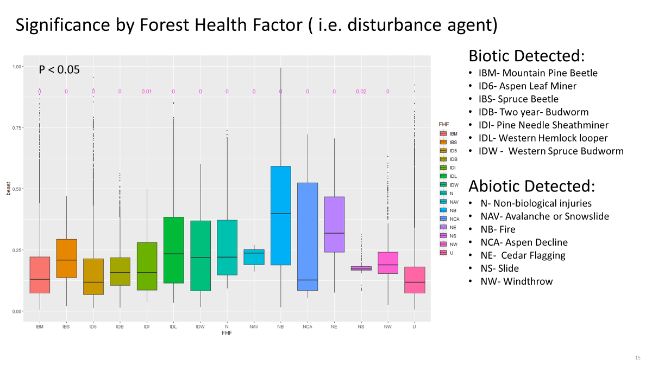
Introduction and Background
Brown et al., (unpublished manuscript)

Slide 10
Research Question
Can we categorize NSRs as abiotic or biotic based on commonly used spectral indices?
Which indices are most sensitive to abiotic vs. biotic disturbances?
As my research is a multi year study can the same model be applied over multiple years?

Slide 11
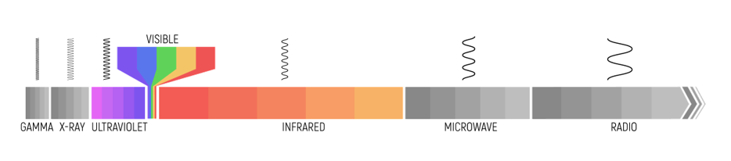
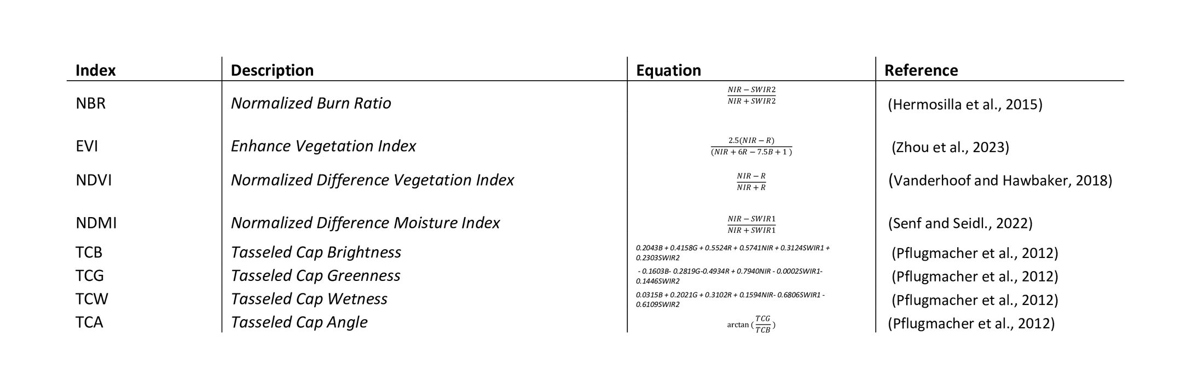
Methods
Indices
Multiple Landsat bands can be combined into a single metric using a variety of equations, referred to as a spectral index (Matsushita et al., 2007).
There are numerous spectral indices being used over single bands to observe different landcover changes, as combining multiple bands can amplify a desired feature (i.e., greenness of vegetation, char, water, etc.) and reduce unwanted atmospheric and topographic noise (Hislop et al., 2018). This project will use most common indices for disturbance.

Slide 12
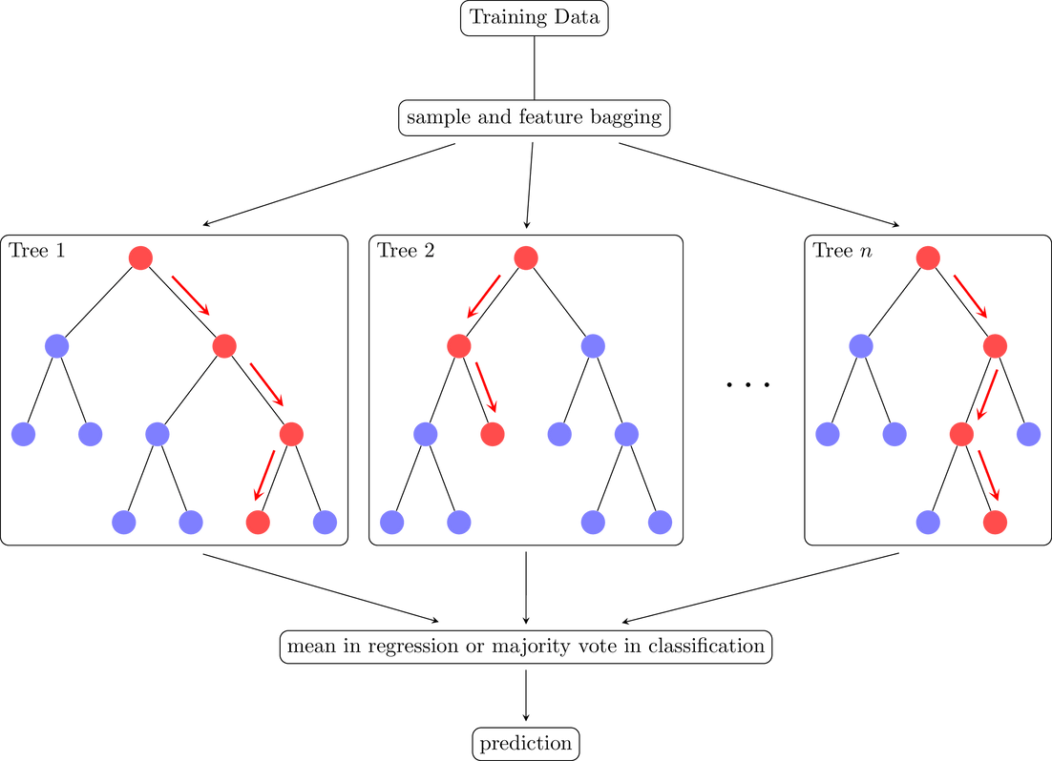
Methods
Random Forest (RF)
Random Forest Regression Algorithm developed by Breiman (2001) is an ensemble of machine learning algorithms that operates through a combination of classification and regression trees (CART) and bootstrap aggregation.
CART are predictive models that creates splits in various attributes in a dataset. These splits are generally based on data being higher or lower than a certain value allowing for predictive variables to be determine.
CART on its own often leads to over fitting to the training dataset, so bootstrap aggregation is used as a resample technique creating an many models reducing the overfitting (Rokach & Maimon, 2007; Sapathy et. al., 2016)
Has become a popular and widely used tool for non-parametric scientific problems ( Strobl et al., 2008).
Riebesell. (2022)

Slide 13
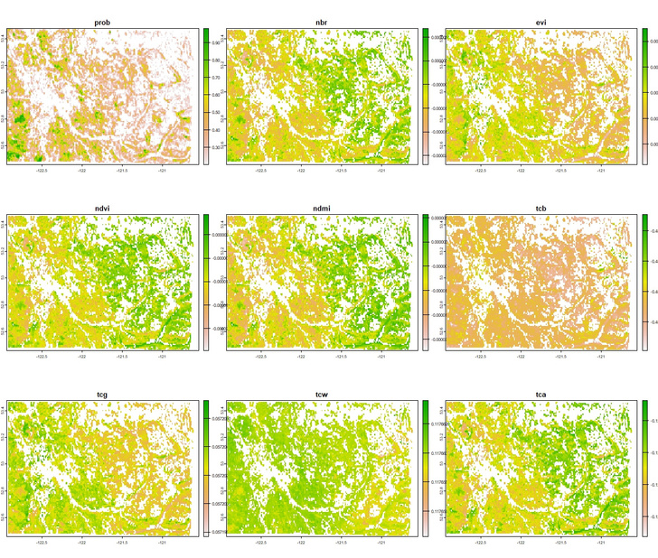
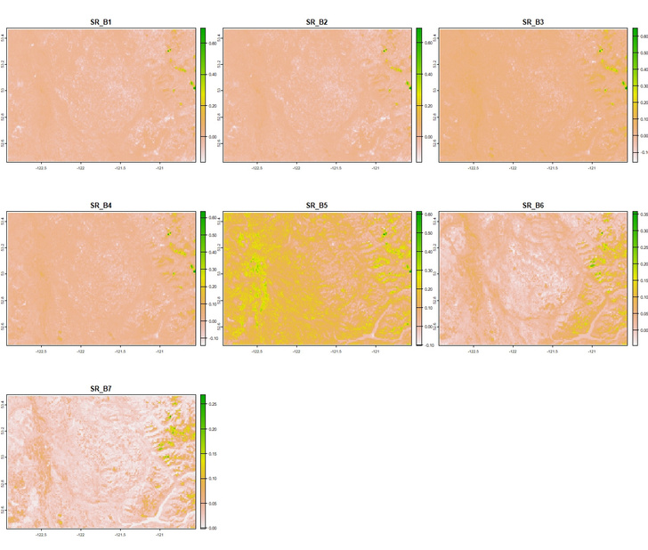
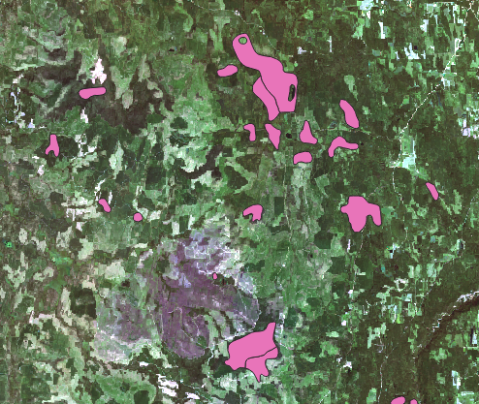
Methods
2020 survey data, 100 points extracted from abiotic disturbances, 100 points extracted from biotic disturbances
Landsat 8 Bands ( coastal blue, blue, green, red, near-infrared, shortwave 1, shortwave 2 ) From 2020 Best Available Pixel (BAP; GEE, 2024)
Threshold Indices calculated indices (NBR, NDVI, EVI, NDMI, TCB, TCG, TCW, TCA ) - BEAST (<0.2)
Model Testing and Evaluation ( On testing data and model applied to 2019 data)
Random Forest Classifier (80% training, 20% testing)

Slide 14

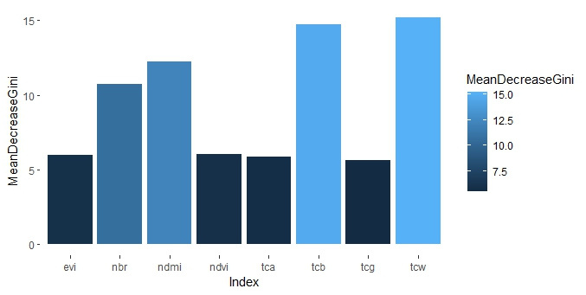
Results
2020 Data
Out of sample accuracy 0.8974
Importance's of indices most to least; TCW, TCB, NDMI, NBR, NDVI, EVI, TCA, TCG) using Mean Decrease Gini ( Menze et al., 2009; how variable contributes to homogeneity of the node).
2019 Data
See if there is overfitting to the selection of disturbances in 2020 data.
0. 785 accuracy on the 2019 data, suggesting the model isn’t overfitting the 2020 dataset an excessive amount

Slide 15






Discussion
The is some covariance between indices which should be considered in further work
This project did take place in the same area which we need to consider, it would be worth while to see out it works in different environments or if needs to be retrained.
Further work could be done to differently categorize but more consideration will probably be needed for physiological mechanisms for disturbances agents or look initial detection sensitivity to different indices
Managements and response tactics to abiotic vs. biotic disturbances could be very different so even broad categorization could be useful.
Has applications for broad categorization that can further investigated with finer scale, ground truthing or more finally tuned models.
We are different!

Slide 16
References
Breiman, L. (2001). Random Forests. Machine Learning, 45(1), 5–32. https://doi.org/10.1023/a:1010933404324
Coggins, S. B., Michael A. Wulder, Nicholas C. Coops, & Joanne C. White. (2008). Linking Survey Detection Accuracy with Ability to Mitigate Populations of Mountain Pine Beetle. *The Forestry Chronicle, 84*(6), 900–909. https://doi.org/10.5558/tfc84900-6.
Google Earth Engine (GEE; 2024). Landsat 8 Surface Reflectance, 30m. Google. https://developers.google.com/earth-engine/datasets/catalog/LANDSAT_LC08_C01_T1_SR
Hermosilla, T., M. A. Wulder, J. C. White, N. C. Coops, and G. W. Hobart. (2015). Regional Detection, Characterization, and Attribution of Annual Forest Change from 1984 to 2012 Using Landsat-Derived Time-Series Metrics. *Remote Sensing of Environment, 170*, 121–132. doi:10.1016/j.rse.2015.09.004.
Hislop, Samuel, Simon Jones, Mariela Soto-Berelov, Andrew Skidmore, Andrew Haywood, and Trung Nguyen. (2018). Using Landsat Spectral Indices in Time-Series to Assess Wildfire Disturbance and Recovery. *Remote Sensing, 10*(3), 460. https://doi.org/10.3390/rs10030460
Li, Jing, Zhao-Liang Li, Hua Wu, and Nanshan You. “Trend, Seasonality, and Abrupt Change Detection Method for Land Surface Temperature Time-Series Analysis: Evaluation and Improvement.” Remote Sensing of Environment 280 (October 2022): 113222. https://doi.org/10.1016/j.rse.2022.113222.
Matsushita, B.; Yang, W.; Chen, J.; Onda, Y.; Qiu, G. (2007). Sensitivity of the Enhanced Vegetation Index (EVI) and Normalized Difference Vegetation Index (NDVI) to Topographic Effects: A Case Study in High-Density Cypress Forest. *Sensors, 7*, 2636–2651. https://doi.org/10.3390/s7112636
Menze, Bjoern H, B Michael Kelm, Ralf Masuch, Uwe Himmelreich, Peter Bachert, Wolfgang Petrich, and Fred A Hamprecht. “A Comparison of Random Forest and Its Gini Importance with Standard Chemometric Methods for the Feature Selection and Classification of Spectral Data.” BMC Bioinformatics 10, no. 1 2009): 213. https://doi.org/10.1186/1471-2105-10-213.
Mulverhill, Christopher, Nicholas C. Coops, and Alexis Achim. (2023). Continuous Monitoring and Sub-Annual Change Detection in High-Latitude Forests Using Harmonized Landsat Sentinel-2 Data. *ISPRS Journal of Photogrammetry and Remote Sensing, 197*, 309–19. https://doi.org/10.1016/j.isprsjprs.2023.02.002.
Payette, S., Filion, L., and Delwaide, A. (1990). “Disturbance regime of a cold temperate forest as deduced from treering patterns: The Tantare Ecological Reserve, Quebec.” *Canadian Journal of Forest Research, 20*(8), 1228–1241. doi:10.1139/x90-162.
Pflugmacher, D., Cohen, W. B., & Kennedy, R. E. (2012). Using Landsat-derived disturbance history (1972–2010) to predict current forest structure. Remote Sensing of Environment, 122, 146–165. https://doi.org/10.1016/j.rse.2011.09.025
Riebesell, J. (2022). Tikz. GitHub. https://github.com/janosh/tikz
Rokach, L., & Maimon, O. Z. (2007). *Data Mining With Decision Trees: Theory And Applications*. World Scientific.
Satapathy, Suresh Chandra, K. Srujan Raju, Jyotsna Kumar Mandal, and Vikrant Bhateja, eds. (2016). *Proceedings of the Second International Conference on Computer and Communication Technologies: IC3T 2015, Volume 3*. Advances in Intelligent Systems and Computing. New Delhi: Springer India. https://doi.org/10.1007/978-81-322-2526-3.
Senf, C., Seidl, R., 2022. Post-disturbance canopy recovery and the resilience of Europe’s forests. Glob. Ecol. Biogeogr. 31, 25–36. https://doi.org/10.1111/geb.13406.
Shi, Hao, Hanqin Tian, Stefan Lange, Jia Yang, Shufen Pan, Bojie Fu, and Christopher P. O. Reyer. (2021). Terrestrial Biodiversity Threatened by Increasing Global Aridity Velocity under High-Level Warming. *Proceedings of the National Academy of Sciences, 118*(36), e2015552118. https://doi.org/10.1073/pnas.2015552118.
Strobl, C., Boulesteix, A.-L., Kneib, T., Augustin, T., & Zeileis, A. (2008). Conditional variable importance for random forests. BMC Bioinformatics, 9, 307. https://doi.org/10.1186/1471-2105-9-307
Vanderhoof, M., & Hawbaker, T. (2018). It matters when you measure it: Using snow-cover normalized difference vegetation index (NDVI) to isolate post-fire conifer regeneration. International Journal of Wildland Fire, 27. https://doi.org/10.1071/WF18075.
Tompalski, P., Coops, N.C., White, J.C., Goodbody, T.R.H., Hennigar, C.R., Wulder, M.A., et al. (2021). Estimating changes in forest attributes and enhancing growth projections: a review of existing approaches and future directions using airborne 3D point cloud data. *Current Forestry Reports, 7*(1), 1–24.
Wulder, M.A., Masek, J.G., Cohen, W.B., Loveland, T.R., Woodcock, C.E., (2012). Opening the archive: How free data has enabled the science and monitoring promise of Landsat. *Remote Sensing of Environment, 122*, 2–10. https://doi.org/10.1016/j.rse.2012.01.010.
Zhao, K., Wulder, M.A., Hu, T., Bright, R., Wu, Q., Qin, H., Li, Y., Toman, E., Mallick, B., Zhang, X., & Brown, M. (2019). Detecting change-point, trend, and seasonality in satellite time series data to track abrupt changes and nonlinear dynamics: A Bayesian ensemble algorithm. *Remote Sensing of Environment, 232*, 111181. https://doi.org/10.1016/j.rse.2019.04.034
Zhou, Mingxing, Dengqiu Li, Kuo Liao, and Dengsheng Lu. “Integration of Landsat Time-Series Vegetation Indices Improves Consistency of Change Detection.” International Journal of Digital Earth 16, no. 1 (October 2, 2023): 1276–99. https://doi.org/10.1080/17538947.2023.2200040.

Slide 17


Thank you!
7

